Slide 1
HeartHeard: An AI-Powered Mental Health Support Platform
Entrepreneurship Presentation

Slide 2
Our Product
Product Name: HeartHeard
An AI-powered mental health support platform
Offers 24/7 emotional support with real time conversations
Detects emotional states such as stress, anxiety and mood patterns through speech and chat
Provides mindfulness tips and psychologist suggestions
Fully mobile, private and affordable

Slide 3
Questions
Is the business just an idea / opportunity with real potential?
➤ It’s a high-potential app addressing a national crisis in mental health.
Is the product / service viable? (feasibility analysis completed?)
➤ Yes, it uses proven AI and mobile tech with identified public health needs.
Business entering into exciting / growing industry?
➤ Yes, mental health tech and AI are fast-growing global industries.
Business has well-defined target market?
➤ Yes, youth and adults in Pakistan suffering from anxiety and depression.
Does the business have points of differentiation?
➤ Yes, combines AI, emotion detection, and local cultural relevance.
Does the business have sound marketing plan?
➤ Yes, via social media integration, peer forums, and awareness features.
Is the management team experienced / skilled?
➤ Yes, guided by university faculty and supported by technical advisors.
Is the business’s operations’ plan appropriate and sound?
➤ Yes, backed by structured AI, NLP, and mobile dev methodology.
Assumptions (financial on realistic grounds)?
➤ Assumes mobile accessibility and low-cost deployment to ensure reach.
Financial projections completed correctly?
➤ Yes, aims for cost-effective development with high social impact and scalable growth.

Slide 4
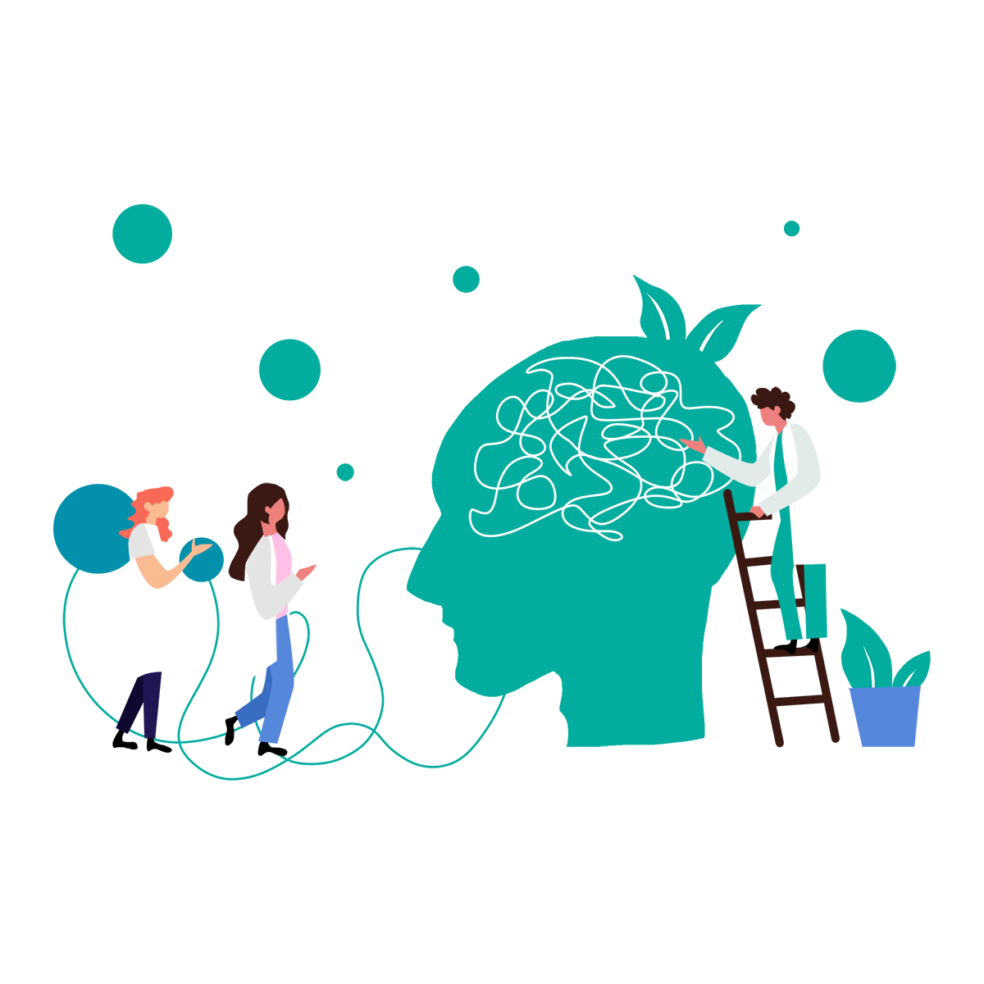
Our Target Market
Age: 18–35 years – early adopters of tech & mental health tools
Smartphone users with daily internet access
Urban & semi-urban college students and early-career professionals
Emotionally aware Gen Z & millennials open to digital therapy Users
open to self-care but hesitant to seek formal therapy

Slide 5
Our Product is
New Way to Deliver Existing Product.
24/7 AI-driven therapeutic conversations with a 3D avatar interface to make interactions feel more human
Personalized mindfulness plans and Mood tracking
Mental health condition detection
Psychologist directory to help users easily discover verified professionals suited to their needs
A safe community space for users to share experiences, find support, and reduce social stigma

Slide 6
How much cash is required for completing this project? ➤ Minimal cash needed—mostly using open-source tools and student resources.
Do we have enough cash (in hand) to complete your final year project? ➤ Yes, HeartHeard is 80% done using free-tier AI/Flutter tools and personal systems.
If not then who is funding your project? ➤ For deployment and processing, our supervisor arranged support from NED’s HPCC Lab.

Slide 7
How your final year project is an opportunity?
Attractive – How? Rising emotional needs and therapy access gaps. Unified platform: chatbot, mood tracking, community support | Timely – When? Now — stress, isolation, digital burnout at peak. Demand growing with life complexity.
Durable – How? Scalable AI and modular architecture. Long-term, growing mental health needs. Covers prevention and crisis care. | Anchor into the Product – How? Features shaped by real-world gaps. Chatbot, emotion tracking, psychologist directory, forum.

Slide 8

Window of Opportunity
Platforms like :
BetterHelp
Talkspace
Woebot
How?
Reduced barriers: cost, stigma, and access.
Used AI/chatbots for real-time, on-demand support.
Gained early traction, validating the market and inspiring new innovators.

Slide 9
How did you identify an opportunity?
Observing Trends “yes / no” (which one)_
✅ Yes — Rise in digital mental health solutions globally, increasing openness to AI therapy, and shift toward wellness apps
Solving a problem “yes / no”
✅ Yes — Lack of affordable, empathetic, and stigma-free mental health support — especially in Pakistani society.
Finding gaps in the market “yes / no”
✅ Yes — Existing platforms don’t combine chatbot therapy, local therapist discovery, mood tracking, and culturally relevant community support in one unified app.

Slide 10
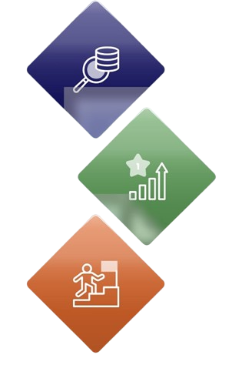
Four feasibility analysis
Product/Service Feasibility:
Industry & Target Market Feasibility:
High desirability: 1 in 5 adults face mental health issues (WHO)
Strong demand: 50% prefer digital therapy; 25% annual market growth
.
$380B industry, reaching $536B by 2030
70% of millennials seek digital mental health services
Organizational Feasibility:
Financial Feasibility:
Skilled team in AI & psychology
Access to cloud tools + professional partnerships
Low-cost setup using free tools & university support
35% ROI in 3 years (Statista, 2023)

Slide 11
1st feasibility
Product Desirability? Yes , How many: 8 out of 10 users (80%)
Product Fulfilling Our Customer Needs? Yes
How?
Provides accessible, stigma-free mental health support. Offers self-assessment, therapy tools, and community support.
What %: 85% user satisfaction
Customer Needs Not Fulfilled by Competitors (Market Gap):
Lack of emotionally intelligent AI for continuous support.
No unified platform combining therapy, tracking, and community.
Limited focus on youth and regional mental health stigma.
Poor personalization in existing apps for daily emotional check-ins.

Slide 12
Concept Statement
Product/Service
AI-based chatbot offering voice/text therapy, mood tracking & community support.
🎯 Target Market
Pakistani youth (18–30), especially students and early professionals avoiding traditional therapy
.
💡 Why HeartHeard?
24/7 support, personalized insights, voice input, emotional trend tracking, and peer connection.
📌 Positioning vs Competitors
Only app in Pakistan that analyzes chats for condition detection + includes community support groups.
👥 Management Team
Final-year Software Engineering students from NED with skills in AI, NLP, Flutter, and cloud deployment, guided by faculty and industry mentors.
.

Slide 13
Buying Intention Survey
Conducted (Y/N) __Yes_________
Questions asked during buying intention survey?
Would you be interested in using an AI-based chatbot that offers mental health support Result Yes __87__ %
Would you consider subscribing to personalized therapeutic plans if they are affordable? Result Yes _74___%
Do you prefer text or voice-based support instead of traditional in-person therapy for privacy and ease? Result Yes ___79_ %
Do you believe a mobile app offering chat support, exercises, and condition analysis would be helpful? Result Yes _91___ %
Would you recommend this app to a friend dealing with stress or anxiety?
Result Yes _85___ %

Slide 14
Key success factors of product (USP)
AI Mental Health Chatbot
Real-time empathetic support + mental health condition detection.
Personalized Recommendations
Tailored therapy plans and self-care exercises.
Culturally Sensitive Community
Safe, stigma-free space for Pakistani users to share.
Hybrid Monetization Model
All-in-One Mental Health Solution
Free core features + affordable premium options..
Combines tracking, therapy, chat, and community in one app.

Slide 15
Challenges & Risks being faced by us
Challenges
Lack of localized mental health training data
Building user trust for emotional conversations
Balancing free and paid feature integration
Limited technical and financial resources for deployment (as students)
Risks
Difficulty in scaling the project beyond university scope
Limited user adoption if awareness efforts are weak
Feature underperformance due to limited training data

Slide 16
Pro-forma income statement
Description | Jul | Aug | Sep | Oct | Nov | Dec | Jan | Feb | Mar | Apr | May | Jun | Total (PKR)
Net Sales (Revenue)
Sessions Sold | 5 | 8 | 4 | 6 | 8 | 8 | 9 | 10 | 15 | 13 | 14 | 15 | 435
Revenue (Rs. 500/sn) | 2500 | 4000 | 2000 | 3000 | 4000 | 4000 | 4500 | 5000 | 15000 | 6500 | 17000 | 7500 | 216,150

Slide 17
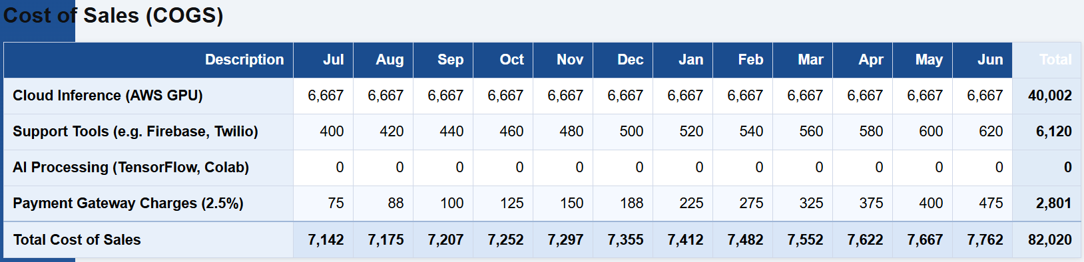
Per month profitability for next 12 months…

Slide 18
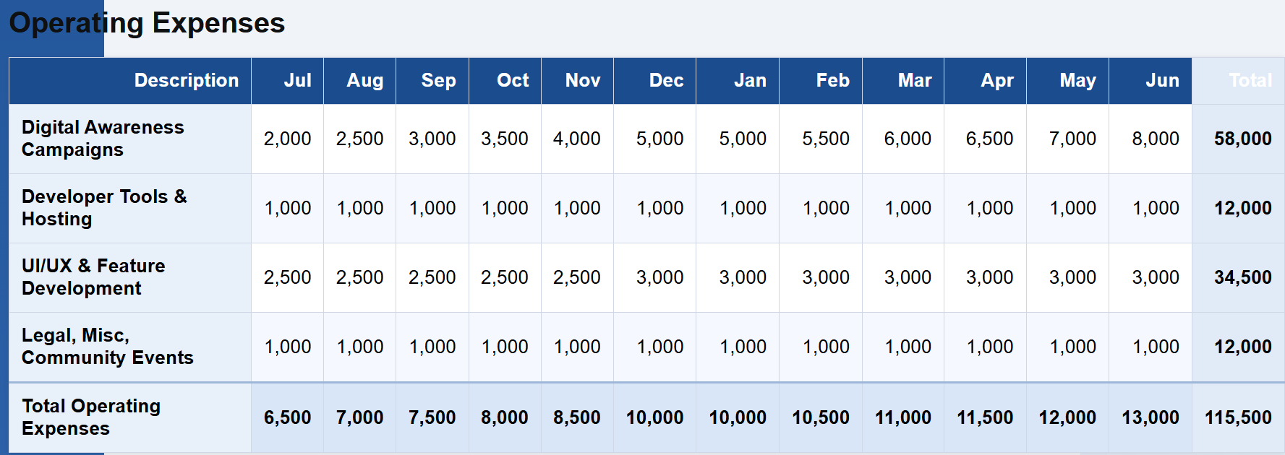
Per month profitability for next 12 months…

Slide 19
Break Even Point After How Many Days?
Month | Monthly Net Loss
Jul | (9,642)
Aug | (8,175)
Sep | (5,707)
Oct | (4,252)
Nov | (3,297)
Avg Burn Rate= 197,520/12​=16,460 per month
=3X16460=49,380

Slide 20
Business Model Innovation
Concept of “Business Model Innovation” being used by us (Y/N) : yes
How?
We are reimagining traditional mental health care by using AI-driven avatars, personalized therapeutic plans, and self-assessment tools, making support accessible, affordable, and stigma-free—especially in underrepresented regions. Our hybrid freemium + AI + human expert model is an innovative approach within digital healthcare.

Slide 21
How your business is making money?
How is HeartHeard making money?
Premium Subscription Plans – Unlock full access therapy plans, mood analytics, and mental health reports.
Avatar Customization – Users can purchase visual or voice upgrades for their AI avatar.
Mental Health Courses & Exercises – Access to exclusive CBT techniques, mindfulness activities, and guided therapies.

Slide 22
Competitors
Direct competitors
Indirect competitors
Woebot
Wysa
Youper
Terapify (online therapy platform)
Traditional in-person therapy clinics
Meditation apps (e.g., Calm, Headspace)
Peer support groups on social media
General-purpose AI chatbots (e.g., Replika)
Mental health awareness YouTube channels

Slide 23
Who is funding our project initially ?
No external funding was required initially. HeartHeard is being developed through bootstrapping. The team is using their personal savings, free-tier tools like Firebase, GitHub, Google Collab, Kaggle, Android Studio, university infrastructure (NED’s HPCC Lab), and other open-source platforms to build and test the app. This approach allows us to maintain ownership, reduce early financial risk, and validate the concept using minimal resources.

Slide 24
Who will fund our project later on means when an organization is growing and fund is needed ?
As HeartHeard grows, future funding can come from:
Health-Tech Incubators & Accelerators – Programs like Invest2Innovate and NEST I/O help early-stage startups scale by offering funding, mentorship, and visibility in Pakistan’s startup ecosystem.
Government Grants & SDG-Focused Programs – Our app supports UN SDG goals like Good Health & Well-Being. This makes us eligible for initiatives such as UNDP Youth Innovation Challenge and Digital Pakistan.
Mental Health Foundations & NGOs – Organizations like the Wellcome Trust and local NGOs support mental health innovation—especially culturally sensitive, AI-based tools for underserved communities.
CSR Initiatives (Corporate Social Responsibility) – Healthcare companies and telecoms often fund digital health projects under CSR to improve public well-being and brand reputation.
Angel Investors & Impact VCs – Investors focused on health tech, AI, or social impact—similar to those who backed Woebot and Wysa—are likely to support scalable, socially-driven apps like HeartHeard.

Slide 25
How much working capital is required ?
To support HeartHeard’s operations for 6 months post-deployment, we estimate a total working capital of:
Category | Amount (PKR) | Why It’s Needed
RunPod.ai (GPU + RAM for 3 AI Models) | 10,000 | For emotion detection (text, voice, image). Based on AWS EC2 (T4g.large + GPU instance) for moderate use.
Marketing & Social Media Campaigns | 5,000 | To build awareness, critical for post-launch as our app is B2C and success depends on early traction so run Insta/Facebook ads, and drive user adoption post-launch.
UI/UX Refinement & Feature Expansion | 5,000 | For improving usability, avatar enhancements, and adding post-MVP features.
Legal & Compliance | 5,000 | Basic app terms, privacy policies, and potential licensing registration.
Play Store App Deployment | 15,000 | For deploying app on playstore to make it easily downloadable to all users
Total Estimated Working Capital (3 Months):
PKR 40,000

Slide 26
Benefits for the customers through our products
24/7 Accessible Mental Health Support
Personalized Therapy Plans
Crisis Alert & Safety Features
Community & Emotional Sharing

Slide 27

Our Tag Line , Our Logo & Our Company Name
HeartHeard
.
Tag Line:
“ Where every Heart is heard.“
(empathetic • inclusive • always there)

Slide 28
Our weak areas / Red Flags and its solutions
Red Flags | How to Overcome These Red Flags
Emotion detection accuracy may be limited at launch | Continuously improve the model using real user feedback and domain-specific fine-tuning.
Session memory and long-term tracking is still developing | Use lightweight local storage techniques and structured session logs with clear privacy controls.
Perception of AI replacing real therapists, | Clearly communicate that HeartHeard is a supportive companion, not a replacement for clinical help.
Limited funding for initial scalability | Begin with an MVP, apply for grants, and seek strategic partnerships to fund incremental scaling.

Slide 29
Type / level of product being offered to Target Market
Core Product
Safe space for emotional well-being & self-expression
Early detection of mental distress
Actual Product
AI chatbot (chat & voice) with human-like empathy
Mood tracking & personalized therapy
User-friendly app with trust-focused branding
Augmented Product
Premium reports & 24/7 chatbot
Community support & session memory
Roadmap for therapist integration

Slide 30
What strategy are we following?
Cost based strategy
How : Freemium Model
Core features (chatbot, mood tracking) are free
Low-cost development using open-source tools
Revenue through premium features (therapy plans, exercises, reports)
Value based strategy
How: Personalized Support
Real-time emotional analysis & AI therapy
Crisis alerts & anonymous story sharing
High user value through personalization & privacy

Slide 31
Our burn rate
Burn Rate (Rs. _____6,215___ per month)
How many days could we survive ___660____ days before we need extra funds?
Metric | Value
Total Capital | Rs. 140,000
Avg Monthly Burn Rate | Rs. 6,215
Months Before Needing Funds | 140,000/6,215 ≈22.4 months
Days of Survival | 22.4×30 = 660 days​
Burn Rate: Rs. 6,215 per month
We can survive ~660 days before needing external funds Break-Even Achieved: Month 6 (December) Sessions Needed to Break Even: ~25–35 sessions/month Total Estimated Working Capital: Rs. 140,000

Slide 32
Type of personal financing that we are using
Bootstrapping – Funding the project using our own personal savings and free resources (e.g., cloud credits, university infrastructure)

Slide 33
Methods that we are using to apply the concept of BOOTSTRAPING
Using personal savings for initial development costs.
Leveraging free tools (e.g., Firebase, GitHub, Figma).
Utilizing university resources (e.g., HPCC at NED for deployment).
Relying on in-house skills instead of hiring external developers/designers.
Marketing through free channels like social media and university events.
Building MVP first to test idea with minimal investment

Slide 34
Our Team
heterogeneous based on the following factors:
Skills Diversity: The team includes individuals with different skill sets, such as front-end development (Ayesha Khan and Areeha Fareed), back-end development, database management, and content expertise (Sadia Sami, Faiza Ashfaq). This diversity of expertise makes your team heterogeneous.

Slide 35
most important personal attributes that strengthen a founder’s (s’) chances of successfully launching a venture
Attributes | Name of Group Members who have this attribute
Project Lead, Full-Stack Contributor & Systems Integrator (Leadership & Strategic Thinking,Technical Versatility, Resilience & Focus) | Faiza
UI/UX Specialist & Design Optimizer (User-Centric Mindset, Consistency & Ownership, Creative Problem Solving) | Areeha
Full-Stack Contributor, Systems Integrator (Collaboration, Analytical Thinking, Problem Solving) | Sadia
Full-Stack Contributor, Systems Integrator (Innovation-Driven, Technical Curiosity, Creative-Execution) | Ayesha

Slide 36
Duration of Elevator pitch- minutes
45 to 60 seconds

Slide 37
Elevator pitch
1st line: Artificial Intelligence is everywhere—ChatGPT, anyone? We used that same idea to create HeartHeard, an AI-powered mental health support platform.
2nd line: Designed for Pakistanis, it offers 24/7 emotional support through a 3D conversational avatar, mindfulness tools, and psychologist recommendations.
3rd line: It also provides a safe community space to reduce stigma and encourage open conversations around mental wellbeing.
4th line: With a freemium model and premium therapy plans, HeartHeard is set to revolutionize how Pakistanis access care—making it scalable, stigma-free, and deeply human.

Slide 38
Elevator pitch (paragraph form)
Artificial Intelligence is everywhere—and people love talking to it. ChatGPT might ring a bell! We used this exact insight to build HeartHeard, an AI-powered platform designed to support mental health in Pakistan—a society where seeking help is often stigmatized. HeartHeard provides 24/7 emotional support through a conversational 3D avatar, mindfulness tools, and psychologist-backed suggestions, making mental health care accessible, affordable, and always available. It also offers a safe, anonymous community space where users can share stories and break the silence around emotional struggles. With a freemium model and an optional premium tier that unlocks personalized therapeutic plans and mental health reports, HeartHeard is not just a product—it’s a movement to transform how Pakistanis approach emotional wellbeing. It's care that’s scalable, stigma-free, and deeply human.

Slide 39
How “entrepreneurship course” could help us in our professional career?
Business Mindset: Cultivate problem-solving skills.
Leadership: Improve team management and decision-making.
Risk Management: Learn to assess and handle risks.
Financial Skills: Understand budgeting and funding.
Networking: Build valuable industry connections.
Market Insights: Analyze customer behavior and trends.
Strategy: Create effective business strategies.
Communication: Improve pitching and negotiation skills.
Innovation: Foster creativity in solving challenges.
Adaptability: Stay flexible in dynamic business environments.

Slide 40
Thank You!

